Slide 1
Mobility @ w-iLab.t Zwijnaarde
Pieter Becue
Vincent Sercu

Slide 2
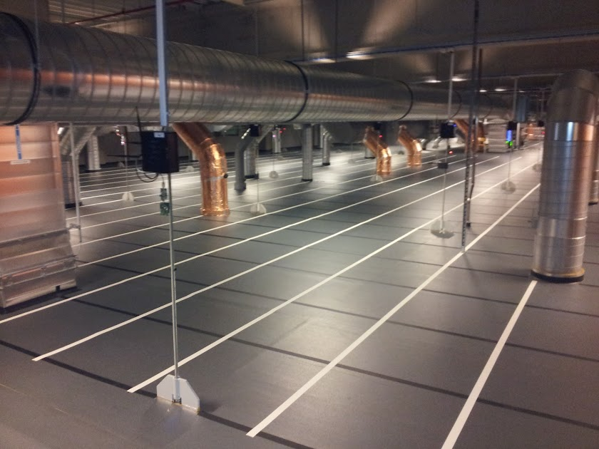
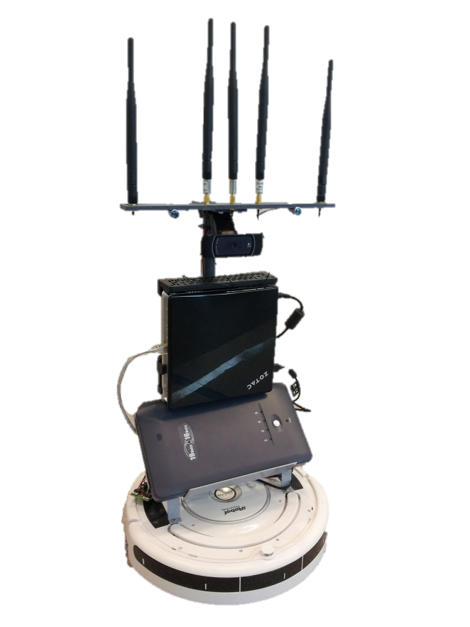
Mobility @ w-iLab.t

Slide 3
Mobility Extension (Zwijnaarde)
allow experiments with mobile nodes
based on vacuum cleaning robot
extended with:
iMinds Robotcontrol
In-house designed circuit board (Power control)
radio for remote control (ez430 – 868MHz)
Embedded PC
Powered by external battery pack
Webcam
Wireless interfaces :
802.11a/b/g/n
Bluetooth
iMinds Rmoni sensor node (802.15.4)

Slide 4
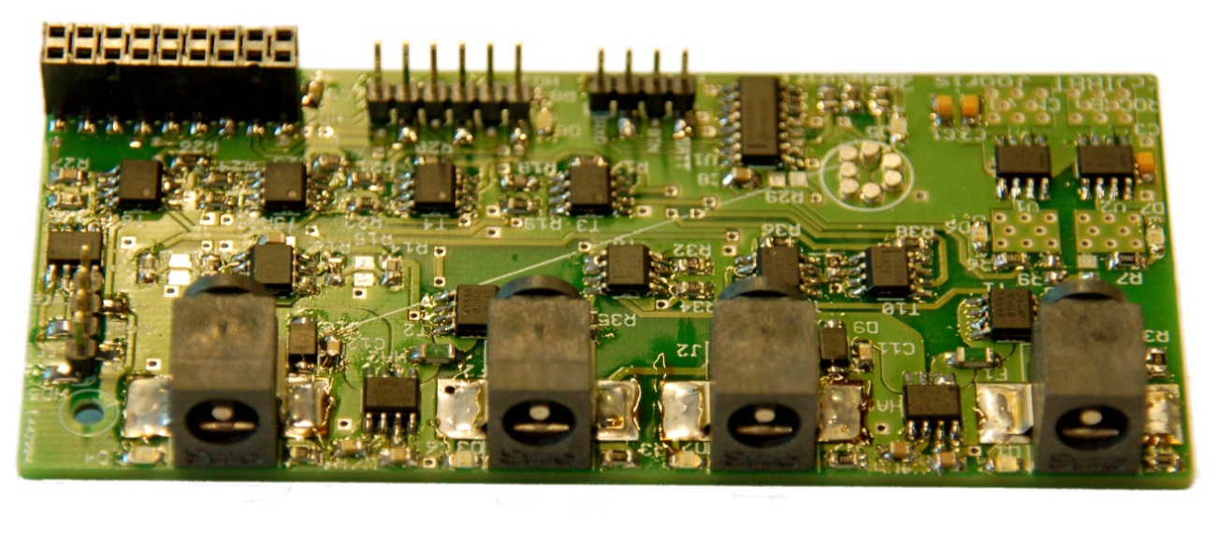
iMinds Robotcontrol
In-house designed
Power distribution
Charge battery pack through Roomba dock (modified)
Power On/Off embedded PC
Toggle robot “eyes” (leds)
Expansion pins
Radio for remote control (eZ430 – 868 MHz )

Slide 5
Controlled & Reproducible
High accuracy positioning algorithm
Full control over experiment node (PC + Sensor)
Fully integrated into testbed (OMF)
User can fully control robot behavior
Mobile node measurements stored through OML

Slide 6
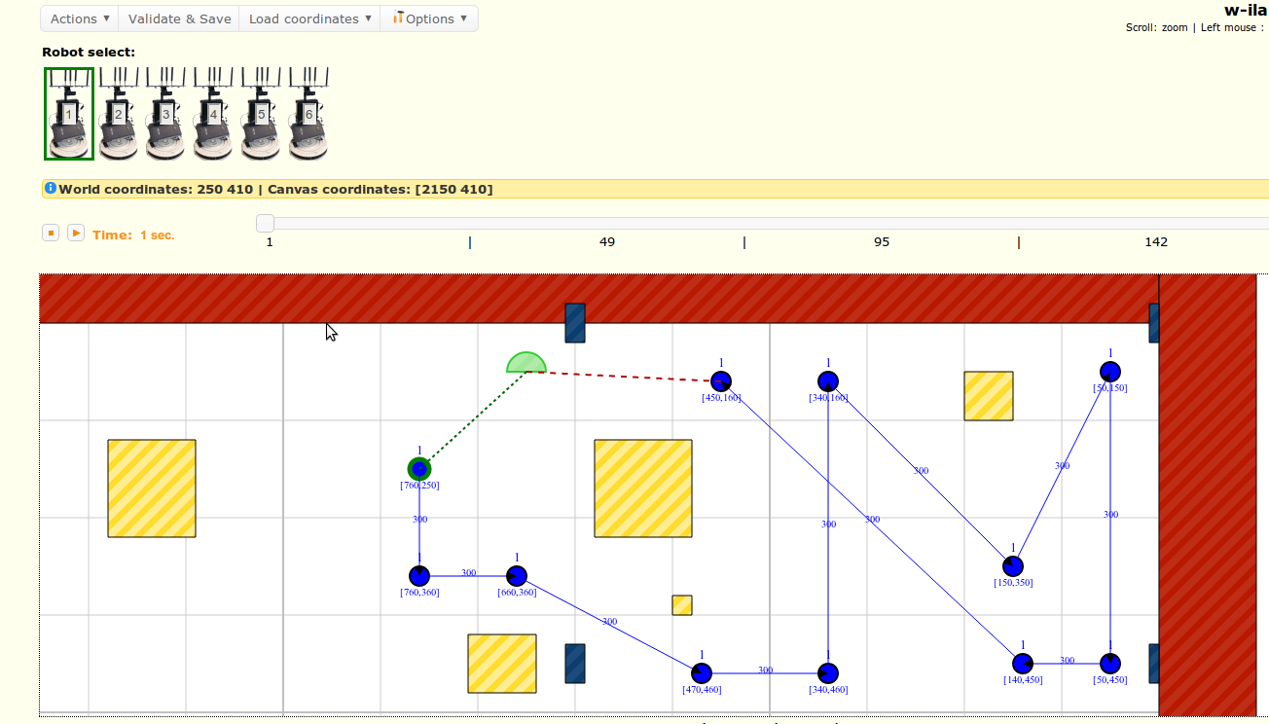
User tools
Network PTZ camera’s
Visual feedback
Easy path generation
Auto-detection of collisions
Between robots
With obstacles
Time-sensitive
Loading/saving coordinate files
→ Used in OMF Experiment Description
With simulator

Slide 7
OMF Integration
New OEDL commands
Start robot path
Based on coordinate files
Auto dock/undock (from safe zone)
Toggle robot “eyes”
Power embedded PC
Custom events
Based on robot position
Known inside ED
Based on measurement data
Execute any OEDL command

Slide 8
Demo
User tools
OMF-integration

Slide 9
The w-iLab.t testbed
Questions?
http://ilabt.iminds.be
details:
www.crew-project.eu/portal/w-ilabt
pieter.becue@intec.ugent.be
bart.jooris@intec.ugent.be
vincent.sercu@intec.ugent.be
www.ibcn.intec.ugent.be – www.iminds.be
Questions?

