Slide 1
Making NITOS SFA-compliant
Harris Niavis,
University of Thessaly, Greece

Slide 2
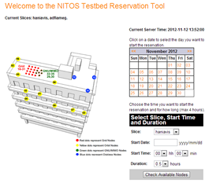
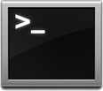
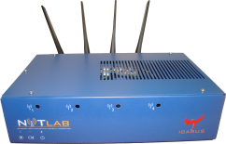
Client side
Server side
Check reservations
periodically
Scheduler scripts
Scheduler Database
users
node_list
spectrum
slices
reservation
spec_reserve
users_slices
Enable/Disable nodes

Slide 3
SFA
The goal is to provide a minimal interface, a narrow waist, that enables testbeds of different technologies and/or belonging to different administrative domains to federate without losing control of their resources.
This will allow researchers to combine all available resources and run advanced networking experiments of significant scale and diversity.

Slide 4
Making NITOS, SFA compliant
SFA Client
1. MySlice plugin
RSpecs
Generic SFA Wrapper
RSpecs
Scheduler Database
NITOS API

Slide 5
Making NITOS, SFA compliant
SFA Client
SFA Client
1. MySlice plugin
RSpecs
2. Define RSpecs
Generic SFA Wrapper
RSpecs
2. Define RSpecs
Scheduler Database
NITOS API

Slide 6
Making NITOS, SFA compliant
SFA Client
SFA Client
1. MySlice plugin
RSpecs
2. Define RSpecs
Generic SFA Wrapper
3. Implement NITOS driver-Rspec parser
RSpecs
2. Define RSpecs
Scheduler Database
NITOS API

Slide 7
Making NITOS, SFA compliant
SFA Client
SFA Client
1. MySlice plugin
4. Implement NITOS API
RSpecs
2. Define RSpecs
Generic SFA Wrapper
3. Implement NITOS driver-Rspec parser
RSpecs
2. Define RSpecs
Scheduler Database
NITOS API

Slide 8
MySlice plugin
SFA Client
RSpecs
Generic SFA Wrapper
RSpecs
Scheduler Database
NITOS API

Slide 9
MySlice plugin
MySlice
A ready-made and easily customizable user interface for testbeds.
Is responsible for providing the testbed resource descriptions.
Provides a modular implementation of independent plugins and a message passing interface shared between them.

Slide 10
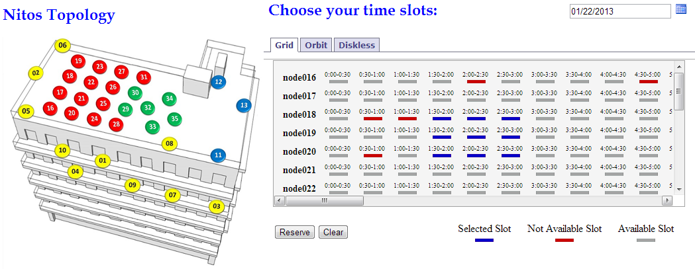
NITOS Scheduler MySlice plugin

Slide 11
Generic SFA Wrapper
SFA Client
RSpecs
Generic SFA Wrapper
RSpecs
Scheduler Database
NITOS API

Slide 12
Generic SFA Wrapper
SFA gives users access to heterogeneous resource types.
The means that SFA uses for declaring which resources a user wants on each aggregate are called RSpecs.(resource specification).
We defined NITOS RSpecs.

Slide 13
NITOS API
SFA Client
RSpecs
Generic SFA Wrapper
RSpecs
Scheduler Database
NITOS API

Slide 14
NITOS API
As much abstract as it could be, in order to be used from different OMF testbeds.
It is an XMLRPC API that exposes all the information of NITOS Scheduler database.
Except from Generic SFA Wrapper, any XMLRPC client could make calls to this API and get responses, if it is allowed to.

Slide 15
NITOS API
The Generic SFA Wrapper will query the NITOS API about the availability of resources and will also make requests for resource allocation on slices.
The NITOS API will receive requests about resource discovery and resource allocation. All it has to do, is just send some SQL queries to the database.

Slide 16
Our ambition
Take advantage of XMLRPC API.
Application in Android, to make the reservation process easier and more user friendly.
Make NITOS Scheduler package, available for all OMF testbeds.
NITOS Scheduler plugin for mySlice
NITOS API
NITOS Scheduler back-end
A tutorial.

Slide 17
Useful links
NITOS Scheduler git repository
https://github.com/NitLab/NITOS-Scheduler
NITOS API git repository
https://github.com/NitLab/Nitos_api

