Slide 1
Building OMF 6.0 Resource Controllers for OpenFlow support
23/01/2013
OpenLab Plugfest
Paris

Slide 2
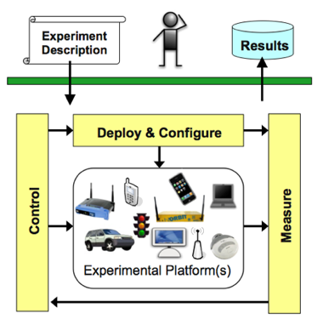
What is OMF?

Slide 3
OMF 6.0
OMF-6 is a new approach, where every resource:
has its own resource proxy or controller (RC)
uses a standardized communication protocol (create, request, configure, release)
The development of RCs is:
scalable
distributed
flexible

Slide 4
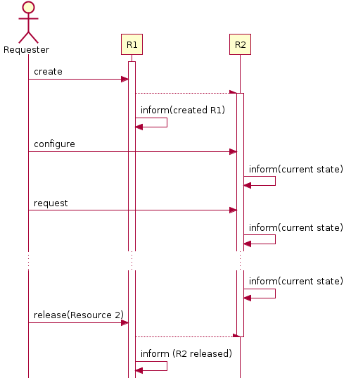
OMF 6.0 communication protocol

Slide 5
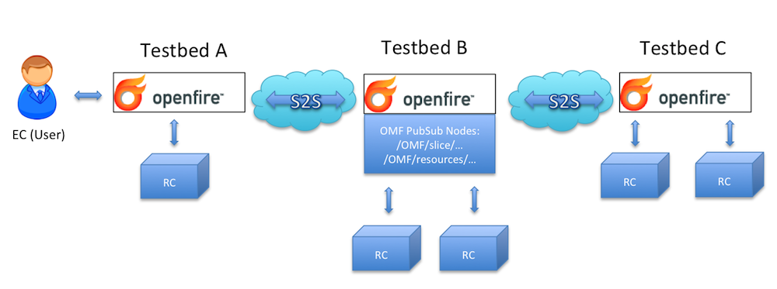
OMF 6.0 xmpp messaging

Slide 6
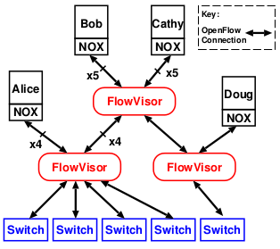
OpenFlow slicing
OpenFlow switch is Software Defined Networking equipment.
OpenFlow controller (NOX) defines the behavior of an OpenFlow switch
FlowVisor creates slices based on the OF switches and assigned to OF controllers

Slide 7
FlowVisor
Stanford developed software tool
Necessary complement to the “slicing framework” of a testbed
Shares the OF switches of a testbed among the testbed users
It creates an OF slice factory

Slide 8
OF Slice Factory & OF slice RCs
The RCs translate the created messages by EC to FlowVisor appropriate commands:
create (OF slice factory → OF slice)
release (OF slice factory → OF slice)
configure (e.g. connections to the FlowVisor)
request (e.g. name of an OF slice)

Slide 9
Useful links
https://github.com/jackhong/omf_rc_foo
https://github.com/kohoumas/omf_rc_openflow

